Slide 1
TF (Term Frequency)-IDF (Inverse Document Frequency)
TF-IDF is a statistical measure used to evaluate the importance of a word in a document relative to a collection of documents (corpus).
Helps identify words that are important within specific documents, reducing the impact of common words across the entire dataset.
Unlike simple word counts, TF-IDF accounts for the uniqueness of terms across documents, improving the performance of NLP models.

Slide 2

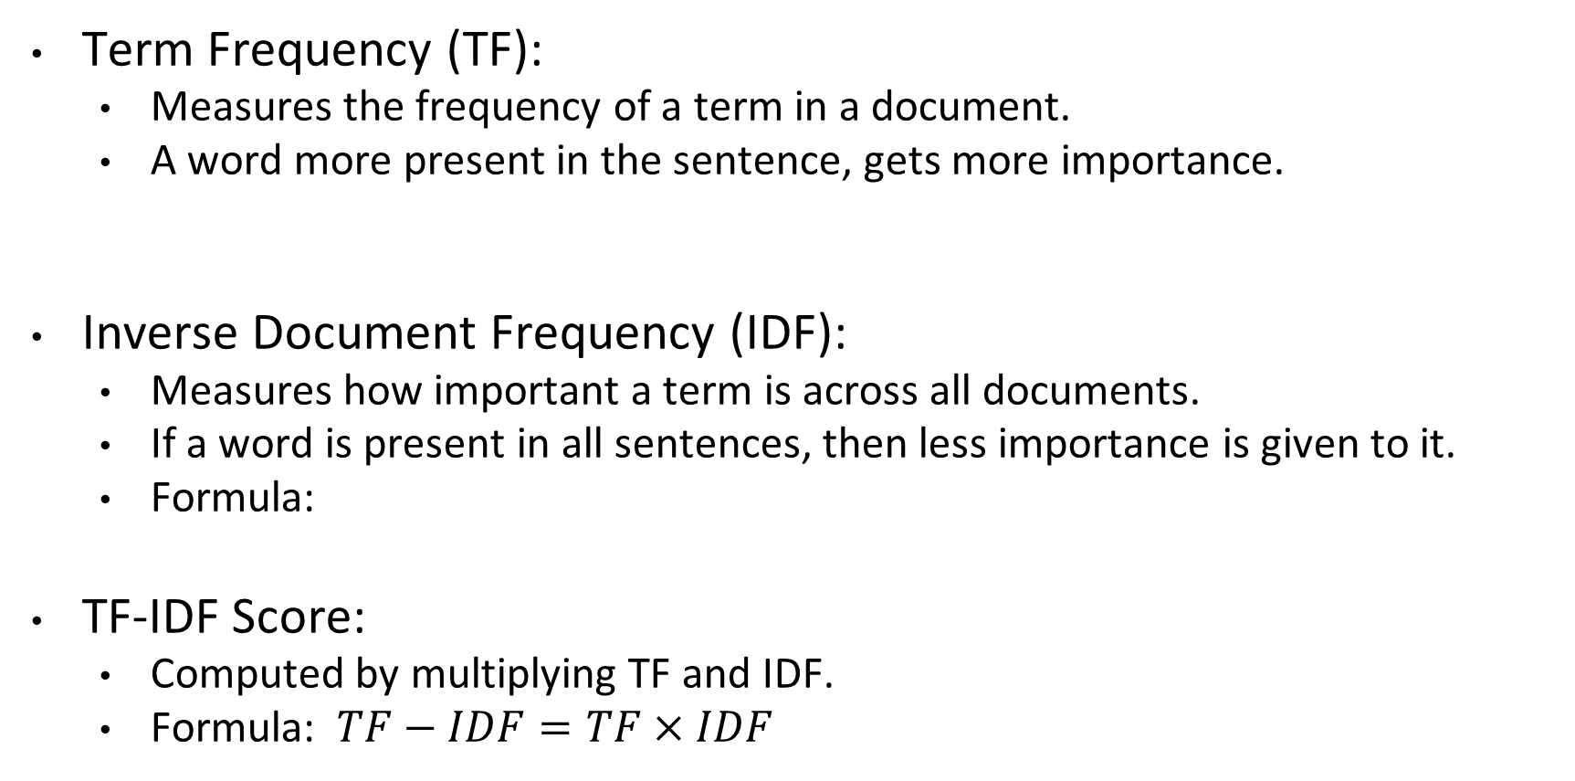

TF-IDF
Term Frequency (TF):
  Measures the frequency of a term in a document.
  A word more present in the sentence, gets more importance.
Inverse Document Frequency (IDF):
  Measures how important a term is across all documents.
  If a word is present in all sentences, then less importance is given to it.
  Formula:
TF-IDF Score:
  Computed by multiplying TF and IDF.
  Formula: $TF−IDF=TF×IDF$
$$TF=\frac{No of rep of word in sentence}{No of words in sentence}$$
$$IDF=\log_{e}({\frac{No of sentences}{No of sentences containing the word}})$$

Slide 3
TF-IDF
How to calculate TF-IDF:
Corpus: ["The cat sat on the mat", "The dog sat on the log"]
Step 1: Compute TF:
  For "sat" in Document 1: TF = 1/6
Step 2: Compute IDF:
  For "sat": Appears in 2 documents, so IDF = log(2/2) = 0
  For "cat": Appears in 1 document, so IDF = log(2/1) = 0.301
Step 3: Calculate TF-IDF:
  Multiply TF by IDF for each term in each document.

Slide 4


TF-IDF
S1 -> good girl
S2 -> bad work boy
S3 -> boy girl good
Vocab: good, bad, boy, girl, work
Term Frequency
 | S1 | S2 | S3
good | 1/2 = 0.5 | 0/3 = 0 | 1/3 = 0.33
bad | 0/2 = 0 | 1/3 = 0.33 | 0/3 = 0
boy | 0/2 = 0 | 1/3 = 0.33 | 1/3 = 0.33
girl | ½ = 0.5 | 0/3 = 0 | 1/3 = 0.33
work | 0/2 = 0 | 1/3 = 0.33 | 0/3 = 0
$$TF=\frac{No of rep of word in sentence}{No of words in sentence}$$
Inverse Document Frequency
good | ln(3/2) = 0.405
bad | ln(3/1) = 1.099
boy | ln(3/2) = 0.405
girl | ln(3/2) = 0.405
work | ln(3/1) = 1.099
TF-IDF
 | S1 | S2 | S3
good | 0.5x0.405= 0.2 | 0x0.405 = 0 | 0.33x0.405= 0
Bad | 0x1.099= 0 | 0.33x1.099=0.36 | 0x1.099= 0
Boy | 0x0.405= 0 | 0.33x0.405=0.13 | 0.33x0.405=0.13
Girl | 0.5x0.405= 0.20 | 0x0.405= 0 | 0.33x0.405=0.13
work | 0x1.099= 0 | 0.33x1.099=0.36 | 0x1.099= 0
$$IDF=\log_{e}({\frac{No of sentences}{No of sentences containing the word}})$$

Slide 5
TF-IDF
Top Features by TF-IDF Score: Prioritizes terms that are both frequent in individual documents and unique across the corpus.
Using max_df or min_df Parameters: These parameters in Tfidf Vectorizer allow further control over feature selection:
max_df can remove terms that appear in a high percentage of documents (too common).
min_df ensures that only terms appearing in a minimum number of documents are included, excluding very rare words.
Advantages
  Intuitive
  Fixed Size - > Vocab size
  Word importance is being captured
Disadvantages
  Sparse matrix still exist
  Out of vocabulary

Slide 6
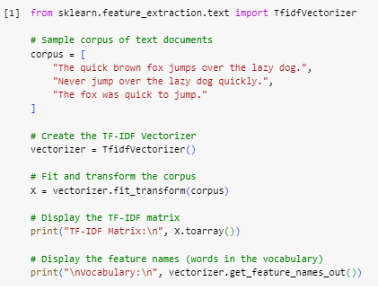
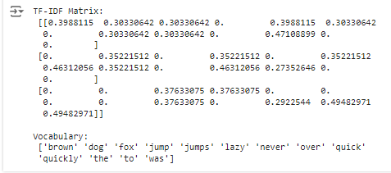
TF-IDF

Slide 7
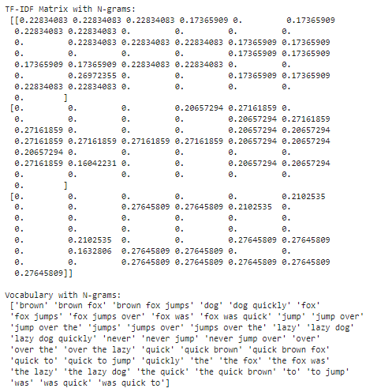
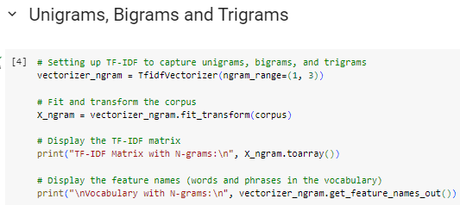
TF-IDF

Slide 8
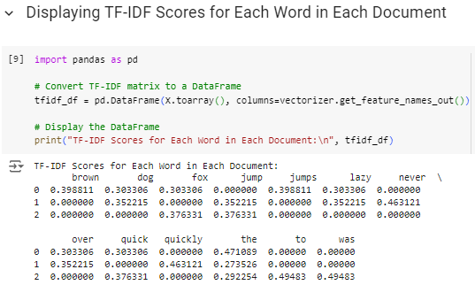
TF-IDF

